Slide 1
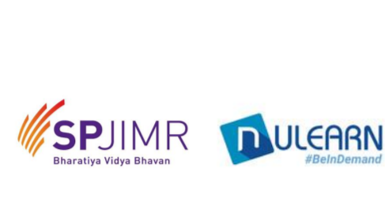
Company Name: XYZ-Wind turnkey India Pvt Ltd. Industry type: Renewables
Assignment 01 : NTCP/ Diamond framework Session dated 01.03.2020
NAME :Reena Vyas
Admission Id: SPJ1125
Post Graduate in Advanced Project Management Blended Programme Batch 33 – PG-APM

Slide 2
Project Vision
To meet the future of Indian electricity demand
The future electricity demand may grow between 3.9 and 4.2 percent CAGR
As of 2017, 73 percent of electricity generation in India was based on coal (Central Electricity Authority, 2017).
The electricity sector (grid and captive generation) consumes over 80 percent of the domestic coal off-take in India
(Ministry of Coal, 2017)
Thermal power plants have been operating at low plant load factors (PLFs) owing to suppressed demand growth and utility-offtake, in addition to coal linkage issues, also not very climate friendly hence renewables is the future
renewable energy (RE) capacity additions have picked up pace as new solar tariffs & Wind farm tariffs keep falling under reverse-bidding
The key demand sectors— industry, residential, commercial and agriculture—continue to be significant contributors to electricity demand growth, whilst also offering the highest potential for energy efficiency
Our company vision is to develop projects of 1000MW to meet energy demand of 2500000 household by this year end

Slide 3
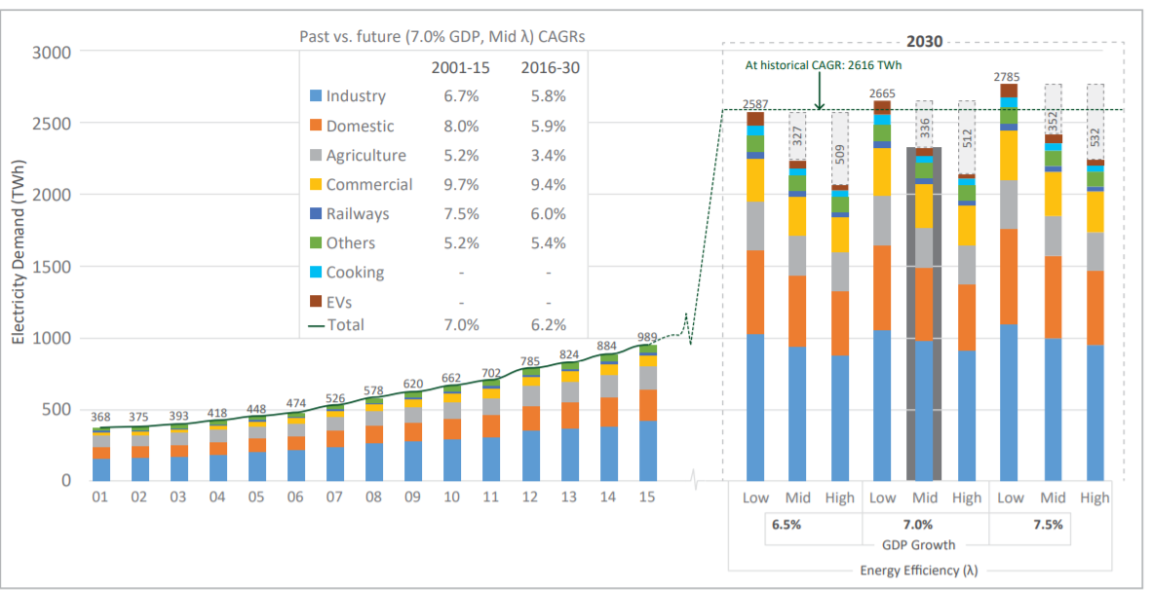
Past Vs future energy demand

Slide 4
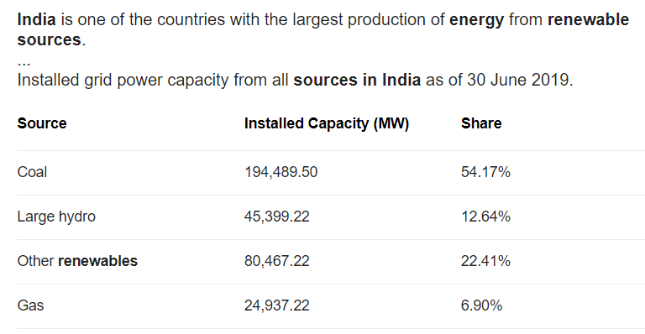
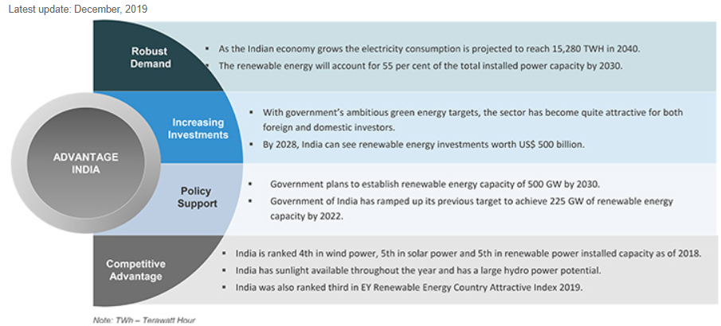
Renewable Energy industry in India
The 22.41% of renewables installed capacity is to supply the demand of 225 GW by 2022
The Indian renewable energy sector is the fourth most attractive¹ renewable energy market in the world
India is among the emerging economies to lead to transition to clean energy
As of October, 31, 2019, the installed renewable energy capacity is 83.37 GW, of which solar and wind comprises 31.7 GW and 37 GW respectively. Biomass and small hydro power constitute 9.80 GW and 4.6 GW, respectively

Slide 5
Project objective
To meet the vision the project objective is divided 5 departments
Origination Team : The objective of origination team is to identify sites/ land with proposed PLF >= 40%. The team is required to get in touch with the vendors to identify the revenue land & private land
WRA team : Wind resource assessment team, analyiz for the wind speed in those identified location, a wind mast of height 120 m is installed in few locations and wind speed is monitored for 12 months. The data thus collected is used to calculate the amount of power generated, as power generated by wind turbine is direct function of wind speed
Electrical Team : To identify the nearest PGCIL s/s, to be connected through their bay to the wind power plant. And to seek necessary approval for bay construction
Land team: To vet the locations approved by WRA team on basis of wind speed. Land team need to ensure the land is not tribal/wild life sanctuary/on shore

Slide 6
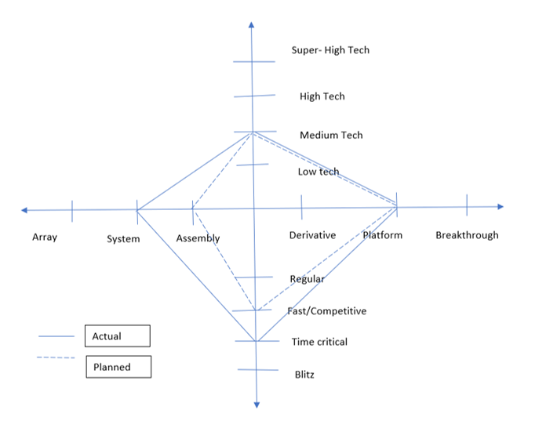
NTCP Diamond Frame Work Wind farm 300MW Project

Slide 7
Analysis NTCP model for the current project in Planned mode
Novelty – a 50 MW WIND FARM PROJECT was first installed in Karnataka, hence the current 300MW project was launched after market research and analysis for the providing renewable energy solutions to the country and to gain competitive edge amongst the rival companies. There fore the project is categorized as a new platform
Technology - With respect to technology this project is categorized as medium tech because of the existing software tools which are menu-driven to conduct required analysis for line losses of wind farm
Complexity - The project is categorized as assembly because company is the OEM of several key electrical component like Wind turbine, power transformer, current transformer & potential transformer and other components as per the BOQ for the wind farm can be readily procured from other OEMS. Thus, direct commissioning & installation of these components in the field is “assembling the Wind farm”
Pace - Since the company consider it self to be startup for a 300 MW, the pace is set up at Fast/competitive, to have the competitive edge in the in the market of providing renewable energy solution

Slide 8
Analysis NTCP model for the current project in Actual mode
Novelty – a 50 MW WIND FARM PROJECT was first installed in Karnataka, hence the current 300MW project was launched after market research and analysis for the providing renewable energy solutions to the country and to gain competitive edge amongst the rival companies. There fore the project is a platform
Technology - With respect to technology this project is a medium tech because of the existing software tools which are menu-driven to conduct required analysis for line losses of wind farm
Complexity - The project is coming to as system because SCADA system which is a system of software and hardware elements that allows industrial organizations to
Control industrial processes locally or at remote locations
Monitor, gather, and process real-time data
Directly interact with devices such as sensors, valves, pumps, motors, and more through human-machine interface (HMI) software
Record events into a log file
Pace - Since the company consider it self to be startup for a 300 MW, and the lack of process excellence delayed certain field activities like commissioning & testing of equipment's/components. The pace turned into at time critical, to the already lost time and maintain a competitive edge by thin margin as the rival’s Wind farm in the same locality were already up & running.

Slide 9
SWOT Analysis of Company
Strengths
Opportunities
Execution team
Huge allotted budget for purchasing software's etc
Experienced COE with 24 years of experience
Individual travel budget to visit sites/vendors/clients
As per the CEA report there is 220GW energy deficit to be met by 2022
Our target is cover 1000MW by year end
There are 7 wind states identified in india, where wind speed is optimum to generate the electricity to meet the plant capacity of 50MW or 300MW
Weakness
Threat
NO induction/orientation
No training/ discouraging he culture of training
No process excellence
No SOP
NO collaboration & synergy
Competitors vying for the feasible land as they are completion their projects much faster
Huge Losses painting the sorry picture of performance
Internal audit is being demanded
Image is tarnished hence vendors shying from giving quotation of electrical work / civil work

